Slide 1

The AES block cipher
Online Cryptography Course Dan Boneh
Block ciphers

Slide 2
The AES process
1997: NIST publishes request for proposal
1998: 15 submissions. Five claimed attacks.
1999: NIST chooses 5 finalists
2000: NIST chooses Rijndael as AES (designed in Belgium)
Key sizes: 128, 192, 256 bits. Block size: 128 bits

Slide 3
AES is a Subs-Perm network (not Feistel)
k_{n}
k₁
k₂
S₁
S₁
S₁
S₂
S₂
S₂
S₃
S₃
S₃
⋯
⨁
input
⨁
output
⨁
⋯
⋯
⋯
S₈
S₈
S₈
subs.
layer
perm.
layer
inversion

Slide 4
AES-128 schematic
10 rounds
4
ByteSub
ShiftRow
MixColumn
ByteSub
ShiftRow
MixColumn
ByteSub
ShiftRow
input
⋯
4
⨁
⨁
⨁
⨁
invertible
k₀
k₁
k₂
k₉
⨁
k₁₀
key
output
4
key expansion:
16 bytes
16 bytes ⟶176 bytes
4

Slide 5
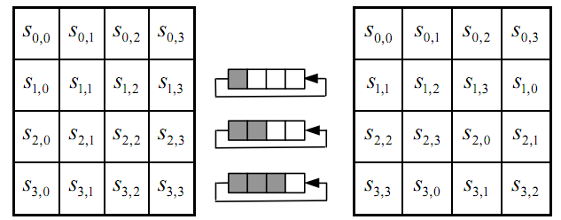
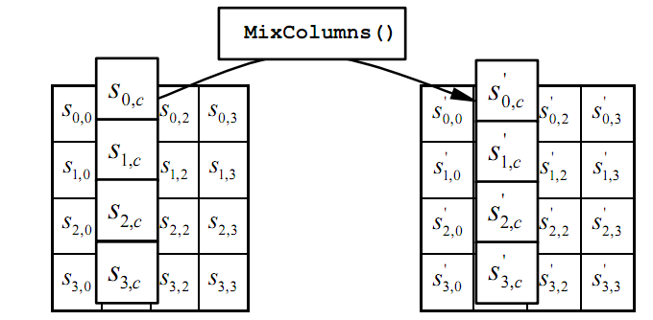
The round function
ByteSub: a 1 byte S-box. 256 byte table (easily computable)
ShiftRows:
MixColumns:
Notes:
S-box is easily computable with little code. All three steps can be combined and accelerated with pre-computed tables.

Slide 6
Code size/performance tradeoff
 | Code size | Performance
Pre-compute round functions (24KB or 4KB) | largest | fastest: table lookups and xors
Pre-compute S-box only (256 bytes) | smaller | slower
No pre-computation | smallest | slowest

Slide 7


Example: Javascript AES
AES in the browser:
AES library (6.4KB)
no pre-computed tables
Prior to encryption: pre-compute tables
Then encrypt using tables
http://crypto.stanford.edu/sjcl/
Notes:
http://crypto.stanford.edu/sjcl/

Slide 8
AES in hardware
AES instructions in Intel Westmere:
aesenc, aesenclast: do one round of AES
128-bit registers: xmm1=state, xmm2=round key
aesenc xmm1, xmm2 ; puts result in xmm1
aeskeygenassist: performs AES key expansion
Claim 14 x speed-up over OpenSSL on same hardware
Similar instructions on AMD Bulldozer
Notes:
To implement AES called aesenc 9 times and then call aesenclast.

Slide 9
Attacks
Best key recovery attack: four times better than ex. search [BKR’11]
Related key attack on AES-256: [BK’09]
Given 2⁹⁹ inp/out pairs from four related keys in AES-256
can recover keys in time ≈2⁹⁹

Slide 10
End of Segment

